Slide 1
Predicting the Severity of an Accident
Hammad Yaqoob

Slide 2
Business Problem
The business problem is to analyse the collision dataset and build a model which can predict under the current condition if a route is dangerous or not based on past accidents
This model can be useful to various navigation systems and car manufacturers as a built in safety feature which could warn users of potential hazardous routes

Slide 3
Background of Problem
According to SDOT Traffic Management Division in 2019 there were over 9000 accidents in Seattle. 32% of those resulted in injuries. In 2020 there have been 2245 accidents. This can be avoided by using collected data to build a machine learning model which can predict whether a route is dangerous based on the current conditions.

Slide 4
Data Acquisition
The data we will be using is provided by the SDOT Traffic Management Division and Traffic Records Group. It has various information of accidents that has occurred from 2004 to the present day.
Includes:
Severity of the incident
Location of the incident
Whether or not the accident was caused due to inattention or if drugs or alcohol was involved or if speeding was involved
Weather at the time of the incident
Road condition at time of incident
Light condition at time of incident

Slide 5
Data Cleaning
Removed incidents where not enough information was present
Removed incidents where X and Y coordinate was not present
Cleaned up columns indication under influence, speeding and inattention to only contain 0 and 1 values
Changed information containing junction type, Address Type, Weather conditions, road conditions and light conditions from categorical data to binary data and removed nulls
Removed information after the incident occurred
Removed ID information about the incident
Removed repetitive information
Data contains 185653 entries and 17 features

Slide 6
Speeding Incidents
Number of accidents with speeding involved: ​8681
Percentage of severity 2 accidents when speeding was involved: 38.2%
Number of accidents with speeding not involved: ​176972
Percentage of severity 2 accidents when speeding was not involved: 30.2%
From the results we can we can conclude that the majority of accidents did not involve speeding and those that did only 38% resulted in severity 2 accidents

Slide 7
Under Influence Incidents
Number of accidents which involved being under the influence: ​8855
Percentage of severity 2 accidents ​which involved being under the influence​: 39%
Number of accidents which did not involve being under the influence: ​176798 Percentage of severity 2 accidents ​which did not involve being under the influence​: 30%
From the results we can conclude that the majority of accidents did not involve being under the influence and those that did only 39% resulted in severity 2 accidents

Slide 8
Inattention Incidents
Number of accidents which involved inattention: ​28754 Percentage of severity 2 accidents ​which involved inattention:​ 35%
Number of accidents which did not involve inattention : ​156899 Percentage of severity 2 accidents ​which did not involve inattention​: 30%
From the results we can see that a significant proportion of accidents were caused by inattention with 35% of those result in severity 2 injuries

Slide 9
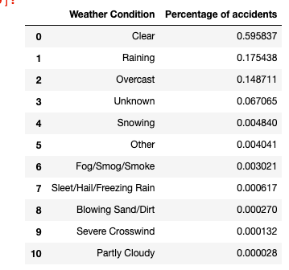
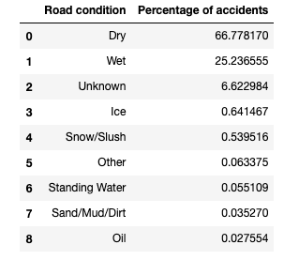
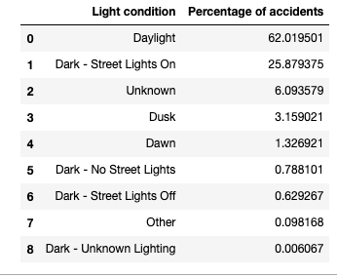
Condition of Incidents

Slide 10
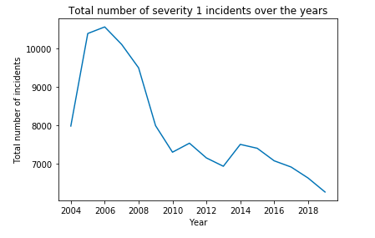
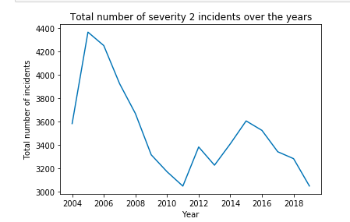
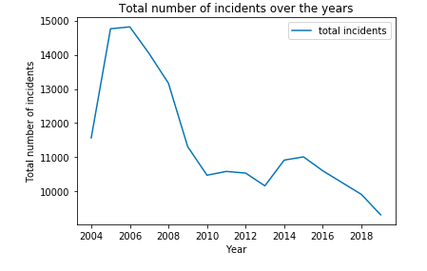
Incidents over the years

Slide 11
Classification Models Used
KNN: This is a classification algorithm which uses supervised learning. When training the model the data points and their classification are plotted. When testing the new data is plotted and depending on the nearest k points the new point is classified. This is ideal as the model needs to classify whether new points will be severity 1 or 2
Decision Trees: This is another classification algorithm where a tree is created based on the training data. Each leaf is a feature and 2 paths coming out of it. Depending on the value of that feature it will follow a certain path. That is how new entries are classified. Since we want to classify the severity of an accident based on the features this algorithm is ideal.
Logistic regression: Logistic regression is a form of linear regression, however where linear regression focuses on predicting continuous values Logistic regression is used to predict categorical values using a similar mechanism. Hence this would be good to use to predict whether the accidents is of severity 1 or 2
SVM works by mapping data to a high-dimensional feature space so that data points can be categorised. Hence this algorithm will be used for classification purposes

Slide 12
Metrics Used to Evaluate Model
● Jaccard Similarity Score: This will prove a score of how many of the predicted values produced by the model match the actual values
● F1-score: This metric uses a confusion matrix to calculate the recall and precision values and then calculates the average to produce the F1-score

Slide 13
Machine Learning Results
 | KNN | Decision Tree | Logistic Regression | SVM
Jaccard Similarity Score | 0.680 | 0.698 | 0.696 | 0.697
F1-Score | 0.637 | 0.605 | 0.601 | 0.603

Slide 14
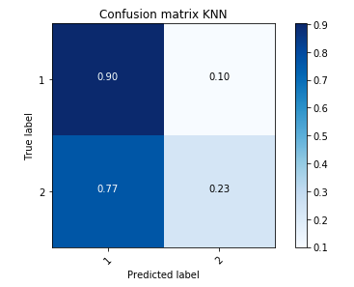
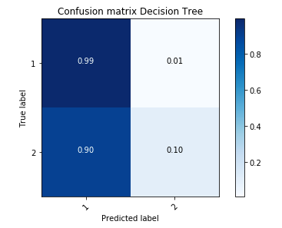
Confusion Matrices

Slide 15
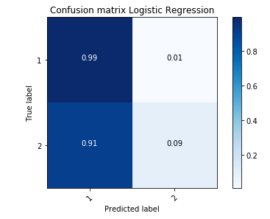
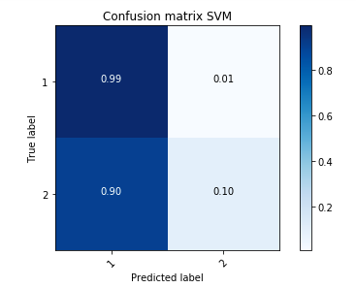
Confusion Matrices continued

Slide 16
Conclusion and Future Work
During the process of this assignment we have analysed the data and during the explanatory analysis stage found the relationships between Light Condition. Road conditions, Weather conditions, Speeding, Under the influence and inattention and traffic accidents and presented the results. We also have mapped the number of incidents per year over the years to show trends
Also we have attempted to create various different classification models to predict the severity of an accident and have found the models are good at predicting when the severity of an accident will be a 1

